Slide 1

Erna Alfi N. ( 2210181002 )

Slide 2


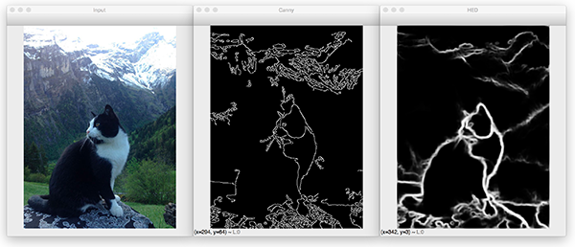
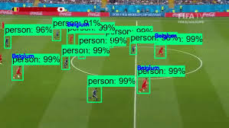
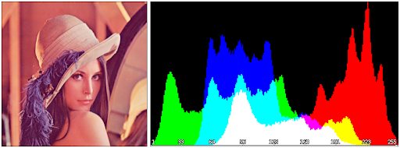
Computer Vision???

Slide 3
Computer vision is an interdisciplinary scientific field that deals with how computers can be made to gain high-level understanding from digital images or videos. From the perspective of engineering, it seeks to automate tasks that the human visual system can do.
Notes:
bidang ilmiah interdisipliner yang membahas bagaimana komputer dapat memperoleh pemahaman tingkat tinggi dari gambar atau video digital. Dari perspektif teknik, bidang ini berupaya mengotomatiskan tugas-tugas yang dapat dilakukan oleh sistem pengelihatan manusia.

Slide 4

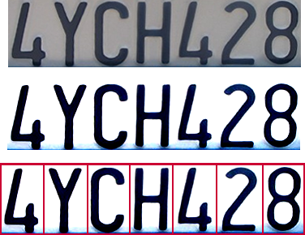
Optical character recognition (OCR)
Technology to convert scanned docs to text
If you have a scanner, it probably came with OCR software
Digit recognition, AT&T labs
http://www.research.att.com/~yann/
License plate readers
http://en.wikipedia.org/wiki/Automatic_number_plate_recognition

Slide 5
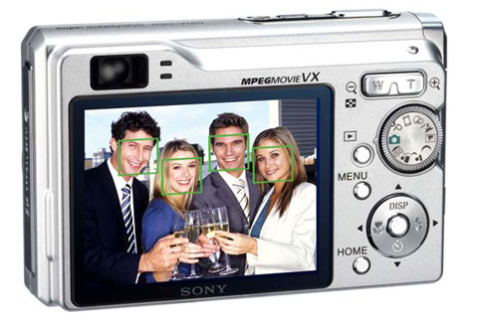
Face detection & Smile Recognition
Smile Recognition
Face Detection

Slide 6
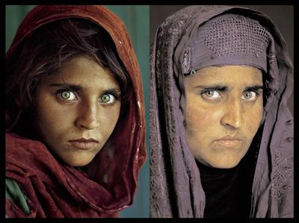
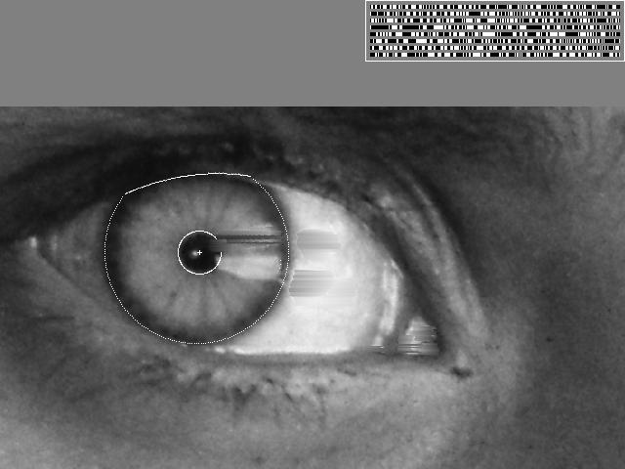
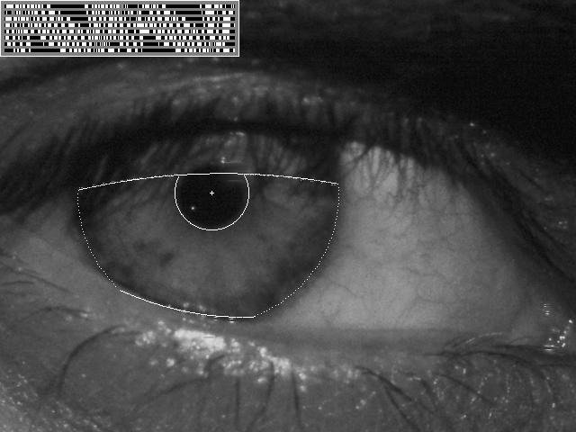
Vision-based biometrics
“How the Afghan Girl was Identified by Her Iris Patterns”

Slide 7


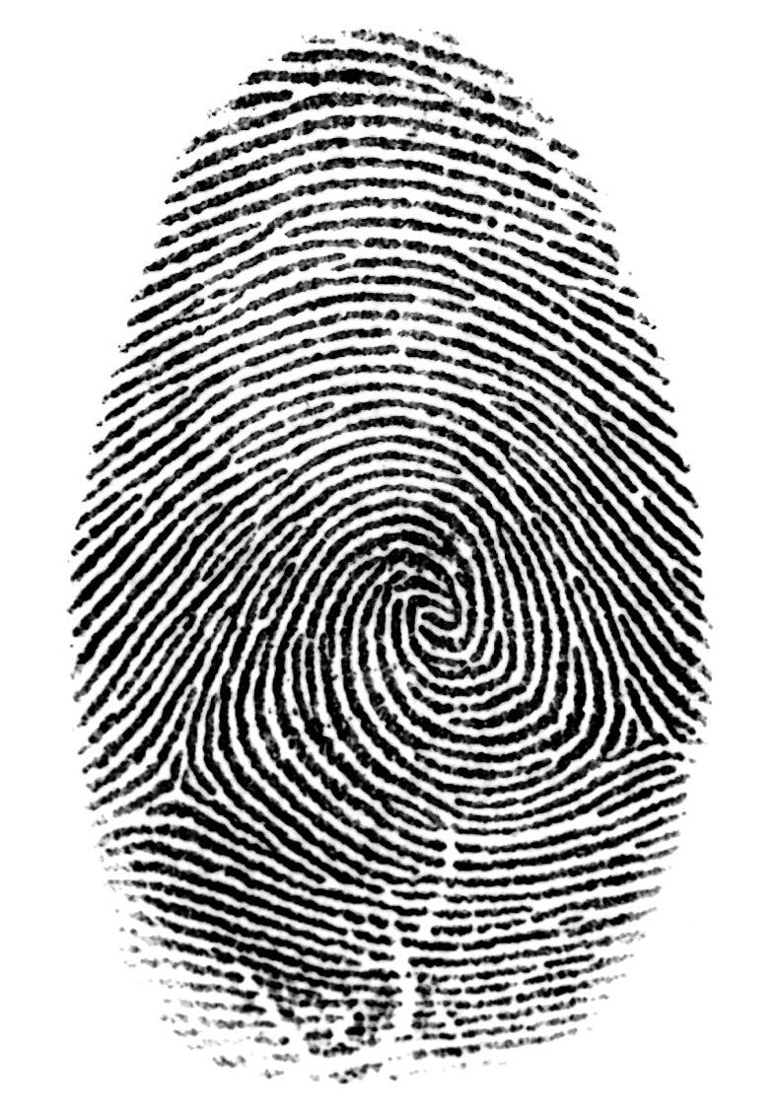

Login without a password…
Fingerprint scanners on many new laptops, other devices
Face recognition systems now beginning to appear more widely http://www.sensiblevision.com/

Slide 8
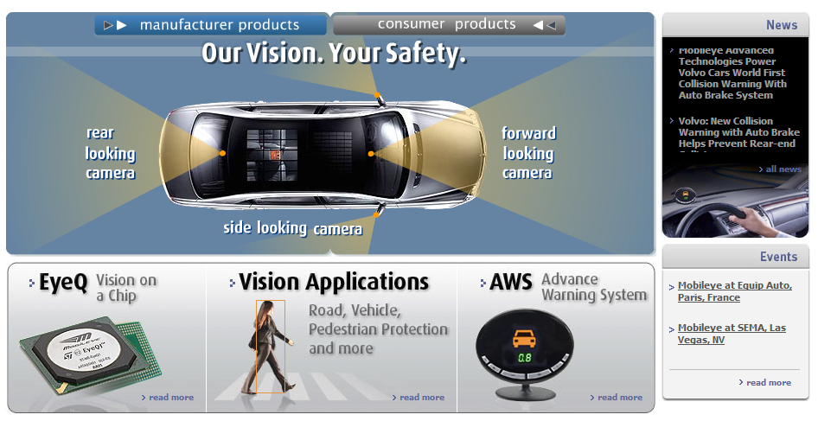
Smart cars
Mobileye
Vision systems currently in high-end BMW, GM, Volvo models
By 2010: 70% of car manufacturers.

Slide 9

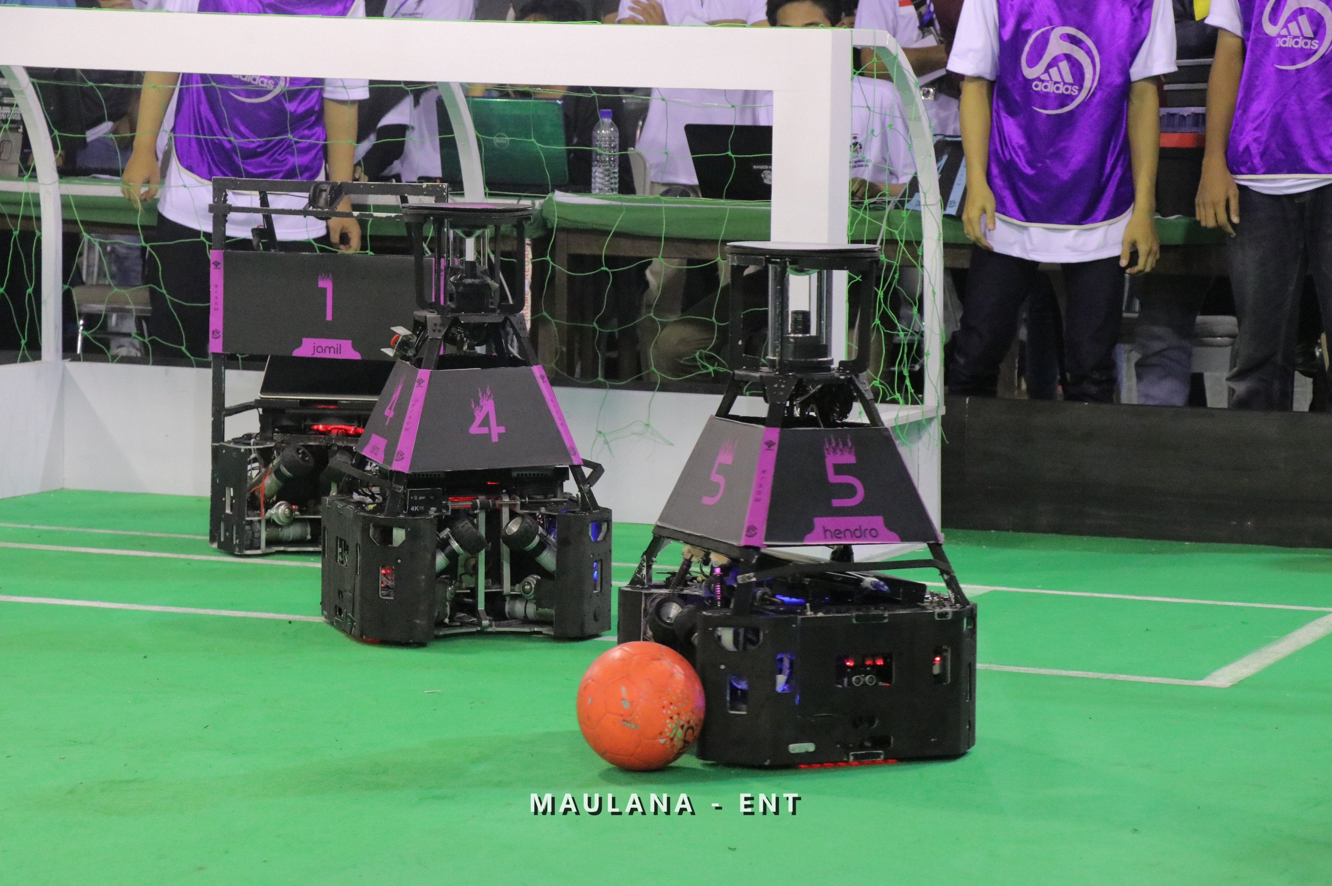
Robotics
NASA’s Mars Spirit Rover
http://en.wikipedia.org/wiki/Spirit_rover
Robot Soccer Ersow

Slide 10
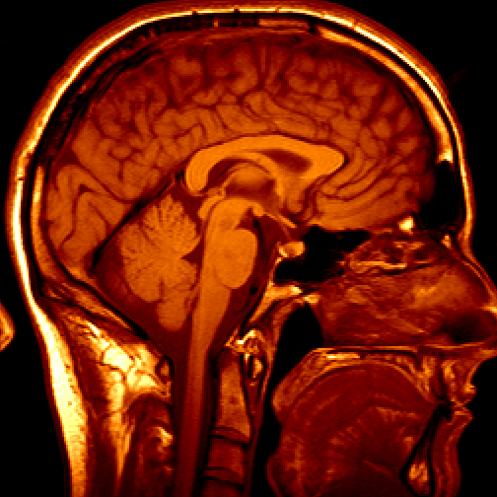
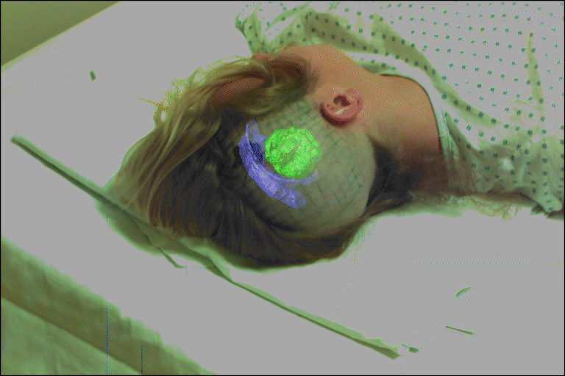
Medical imaging
3D imaging
MRI, CT
Image guided surgery
Grimson et al., MIT

Slide 11

How to Start it??
All about OpenCV:
https://opencv.org/
download library opencv:
https://opencv.org/releases/
Tutorial image processing:
https://docs.opencv.org/master/d9/df8/tutorial_root.html

Slide 12


Projects:
- basic
Capturing image from webcam
Write and save video & image from webcam
Edge Detection
Object detection (threshold)
- intermediate
Face detection
Car detection
- expert
Image recognition using YOLO V3
Ball recognition using Haar Cascade Classifier
Obstacle detection using DNN

Slide 13



Thank You & Good Luck !
More Information:
ernaalfinur14@gmail.com
+6285707930459
ernaalfin_

